Slide 1
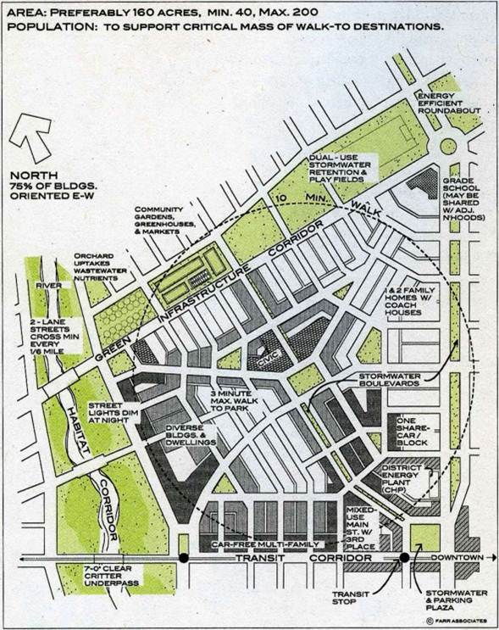
Sustainable Neighborhood Diagram (Farr/Oberholtzer/Schaller)
Defined Center & Edge
Compactness
Completeness
Connectedness
Biophilia
Farr 2008
bettercities.net

Slide 2
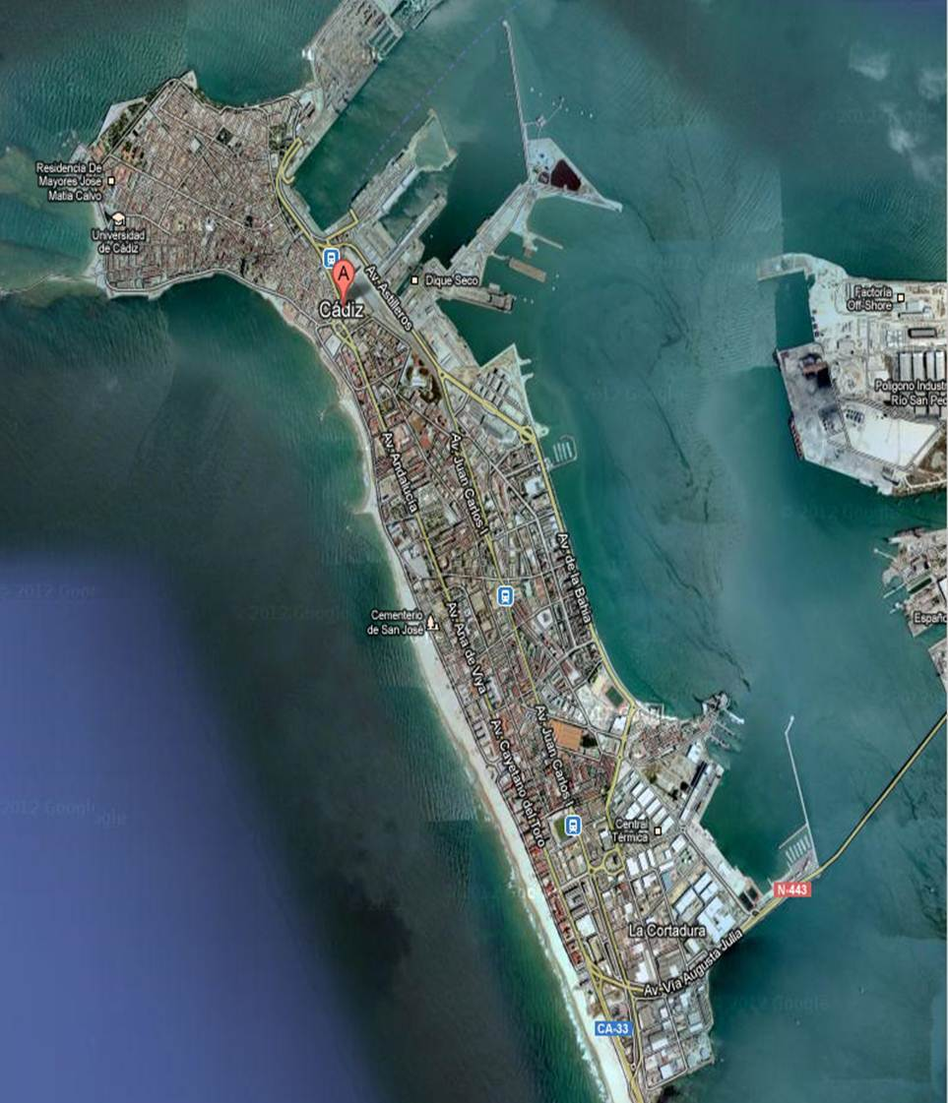
Third Places
Cadiz, Spain

Slide 3
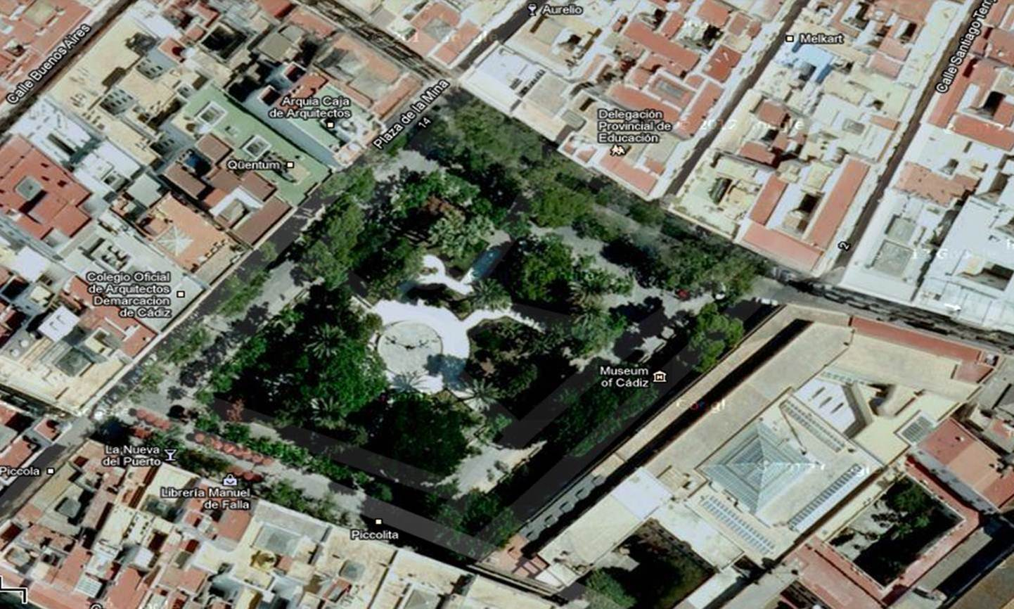
Plaza de la Mina

Slide 4
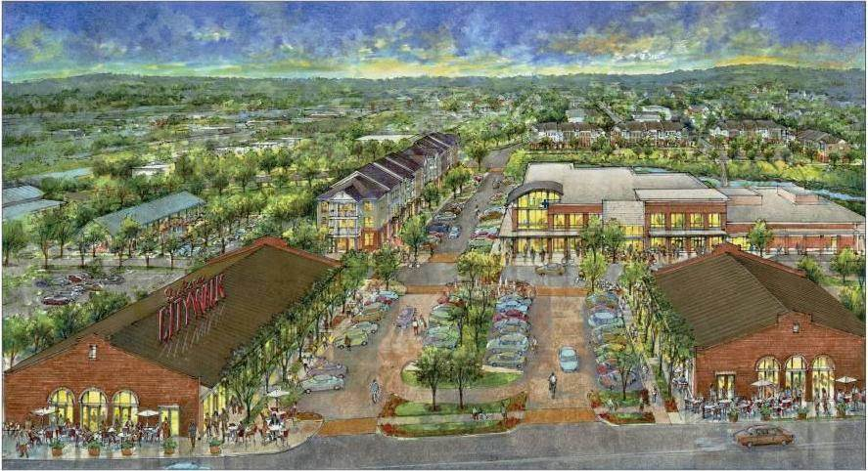
Healthy Neighborhood
www.henryturley.com
Notes:
Jackson Walk | Jackson, TN
Healthy neighborhoods and healthy people will become an increasingly central part of our national dialogue. These conversations will be especially critical for inner city neighborhoods, which we have left to decay for too long. Jackson Walk in downtown Jackson, TN, will help make those emerging conversations a tangible reality. In coordination with the Jackson Center City Revitalization Project, Healthy Community, LLC has partnered with Jackson-Madison County General hospital to provide a unifying vision based on the assumption that a healthy and vital community is safe, clean and orderly, and that it is anchored in excellent schools. This community will encourage healthy living, with a wellness center, a clinic, neighborhood retail and a farmer’s market all within walking distance. On the site, there will be construction of new multifamily apartments, as well as construction of new and rehabilitation of existing single family homes. Jackson Walk will be a place of continual investment in both the well-being of its residents and the vitality of the city of Jackson.

Slide 5
Walkability
www.walkscore.com
Calculates walkability score for an address, neighborhood, town,…
Pitman, NJ:
East Avenue (Downtown): 83 Very Walkable
2500 ft down Broadway: 43 Car Dependent

Slide 6
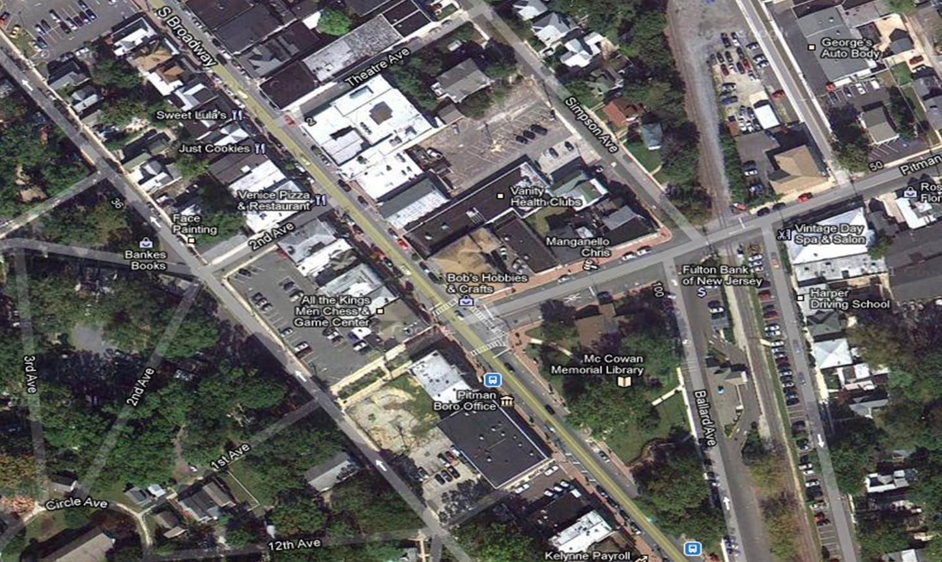
83 Very Walkable
www.walkscore.com
43 Car Dependent, 2500’ →

Slide 7
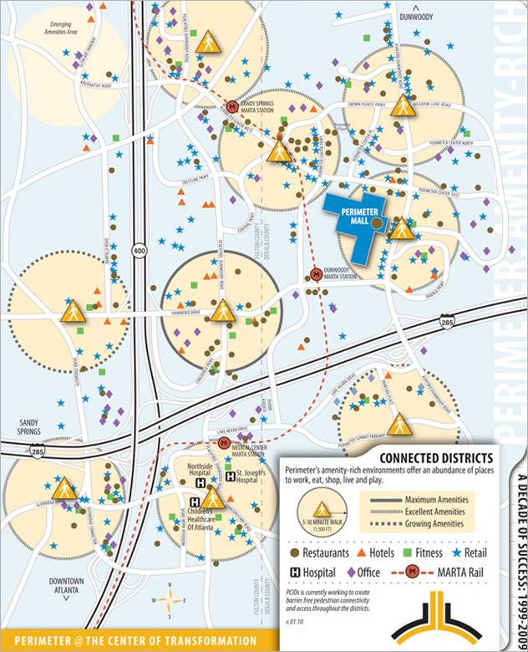
Atlanta, GA
Perimeter Community Improvement Districts
Self-taxing districts that use additional property taxes to help accelerate transportation and infrastructure improvement projects
www.perimetercid.org
Notes:
The Perimeter Community Improvement Districts (PCIDs), representing both the Central (DeKalb) and Fulton Perimeter CIDs, are self-taxing districts that use additional property taxes to help accelerate transportation and infrastructure improvement projects. The PCIDs are leading the charge to implement vital transportation enhancements coupled with land use and zoning strategies that will enhance mobility and improve access to the Perimeter activity center.
The Perimeter business district is the region's largest employer district and one of the largest Class A corporate office markets in the southeast. Perimeter is home to Fortune 500 companies, 125 companies with 100 or more employees, the state's largest concentration of medical facilities, and an estimated population that may be the region's largest by 2025. There are currently more than 110,000 jobs in the corridor, with 35,000 more expected over the course of the next 10 years. Overall, it represents a $3.31 billion real estate investment in metro Atlanta.

Slide 8
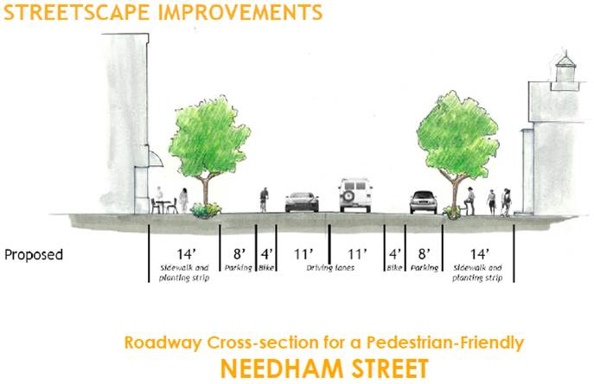
Complete Streets
bikenewton.dreamhosters.com

Slide 9
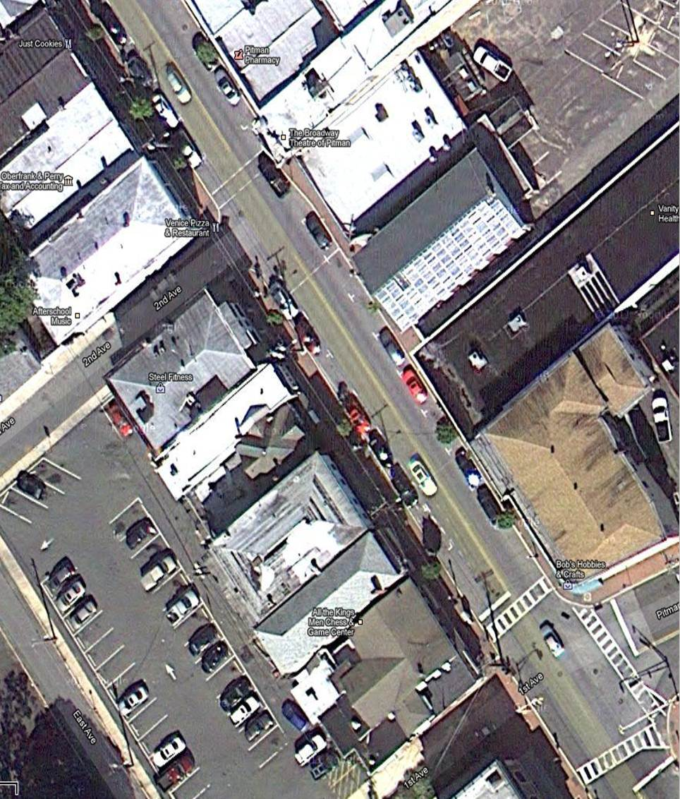
Pitman, NJ

Slide 10
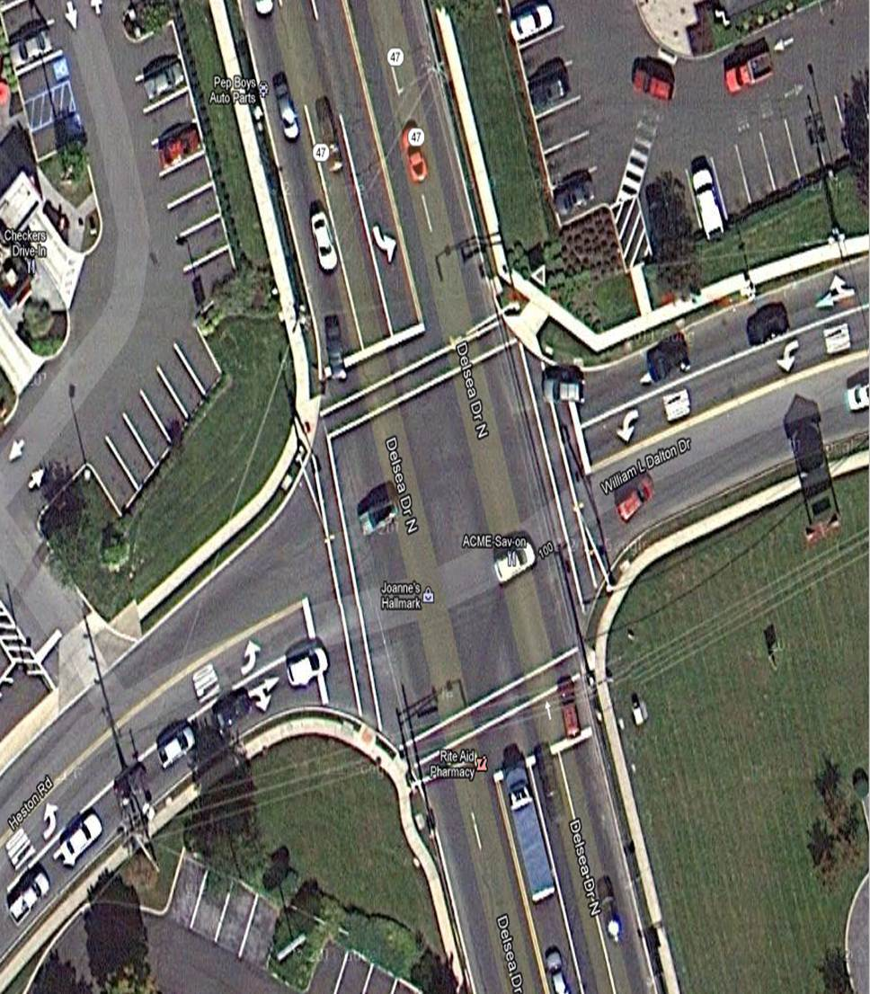
Glassboro, NJ (Delsea & Heston)

Slide 11
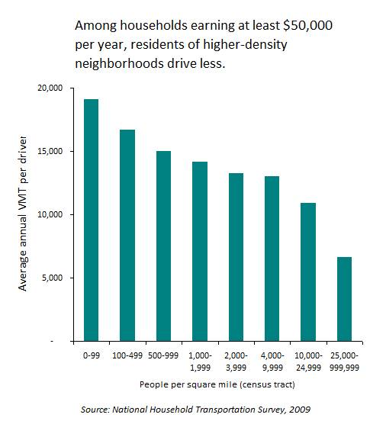
Auto Transit and Density
daily.sightline.org

Slide 12
Zip Car (Car Share)

